Slide 1
Messin’ With Sasquatch Jack Links Jerky Campaign
Hayley Keon
Sam Gest
Frances Paxton

Slide 2
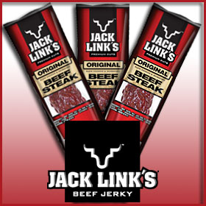
Jack Links- an American Classic
The history of Jack Links Beef Jerky goes back nearly a century, to an entrepreneur staking his claim on land in western Wisconsin. Christopher Links was a knowledgeable jerky producer- and, as the story goes, it was his son Jack that followed in his footsteps and began the Jack Links jerky company out of the back of his truck.
As for competitive advantage, Jack Links holds it own among other producers such as Slim Jim, Oberto, and Pemmican- mainly through its use of popular advertisements, and lays claim to a majority of the 41 million teens that spend upwards of 300 million dollars on meat snacks each year.
Today, the corporation is multinational, with headquarters in Berlin, Germany, Tres Rios, Brazil, Ontario, Canada and Auckland, New Zealand; though production of the jerky still occurs here in the US.

Slide 3
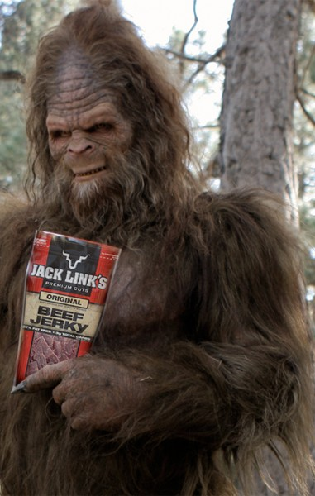
Messin’ with Sasquatch- Bringing Humor to Jerky
Jack Links- and the snack food it produces- already appeals to a specific type of consumer. Continuing along the demographic lines, the Sasquatch ad campaign appeals to young (through middle aged) outdoors enthusiasts, clearly men.
The ads focus on three men who, upon a camping-type experience, happen upon the elusive sasquatch. After each taking a bite of jerky, they feel brave enough to pull some prank on the creature.
Their mischief always ends badly for them.

Slide 4
Messin’ with Sasquatch
Introduced in 2006, the ad campaign has won multiple awards and continues through the present. Sponsoring events such as a student film contest, the ad remains popular and current through constant renovation. Additionally, the company remains in the public eye through sponsoring events like the World Series of Poker Tournament each year.
Through the television and internet ad campaign, Jack Links has reached millions of viewers, though the most accessible are still their tried and true fans.

Slide 5
The Men Behind the ad
Carmichael Lynch Spong, a PR firm, is the silent creator of this ad. They state that the ad is meant to appeal to “action driven men”. They are also the creators of Harley Davidson, Trane Air, Rubbermaid, and Scrabble games.

Slide 6
Strengths and Weaknesses
Strengths
Weaknesses
As an ad campaign that has won 66 awards, the strengths are numerous. The ads are not “wordy” or thought-inducing. The idea of the ad- messing with Sasquatch- is simple to understand; clear through images alone and still able to market both slapstick “boy” humor and appealing to the underdog complex in the end, as we all laugh when Sasquatch gets revenge.
Its colors are bright and appealing, and in using a similar plotline every time, each ad is quickly recognized as a Jack Links trademark.
It is an ad that you remember- catchy, funny- and accurately appeals to the target audience.
Finally, it reaped wanted results. The sale of Jack Links jerky has jumped 47% (according to ACNielson) since the run of the ad.
The most notable weakness is the ad’s inability to expand to a greater audience. It catches its target audience and sticks with it- but, in doing so, it excludes viewers interested in a more serious ad.

